Slide 1
PINK EYE DETECTION USING CNN
TEAM MEMBERS
SUMA - ENG19CS0190
NAMITHA.K - ENG19CS0197
SAHITHI - ENG19CS0205
PARTH - ENG19CS0218

Slide 2
Abstract
Nowadays scientists are focusing on diagnosing certain eye diseases using image processing. Among these diseases, conjunctivitis is a key eye infection to be observed and diagnosed.
Hence, in this project we aim to develop an automated system that is based on facial image processing which analysis eye sclera and extracts features of critical attributes to be used in the diagnosis of the disease.

Slide 3
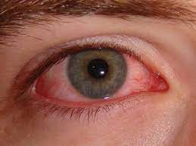
PROBLEM STATEMENT
highly contagious
its quarantine is crucial in ophthalmology clinics as well as doctor’s ofﬁces
Need: System that is automated and non-invasive.

Slide 4
Objectives
To successfully train and build a CNN model that helps in detection of pink eyes
To be able to diagnose patients with mild symptoms, without having to go to a doctor

Slide 5
Road Map
Understanding the problem statement
Literature Survey
Collecting data and forming and dataset
Pre-Processing
Training the model
Testing
Validation

Slide 6
MOTIVATION
Assistance to doctors
Speeds up the process
It standardizes the output
It can be used over the clock anytime, anywhere

Slide 7
INTRODUCTION
Conjunctivitis, also known as pink eye, is the inflammation of conjunctiva.The conjunctiva is a thin clear tissue that lies over the white part of the eye and lies inside the eyelid.
What causes pink eye?
Viruses and Bacteria
Irritants such as shampoo, dust, smoke or pool chlorine.

Slide 8
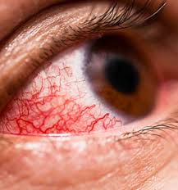
What Are the Symptoms of Pink eye?
Redness in the white of the eye or inner eyelid
Green or white discharge from the eye
Itchy eyes
Swollen conjunctiva

Slide 9
LITERATURE REVIEW
Title | Author | Algorithm used | Outcome
[1]Automated Detection of Adenoviral Conjunctivitis Disease from Facial Images using Machine Learning | Melih Gunay et al | Automated Grabcut Algorithm,RGB thresholding,GLCM | Automatic, fast and cost effective diagnosis
[2]Severity Classification of Conjunctival Hyperaemia by Deep Neural Network Ensembles | Hiroki Masumoto et al | DenseNet201, DenseNet121,VGG19, ResNet50 | This system could be as accurate and comprehensive as specialists but would be significantly faster and consistent with objective values.

Slide 10
LITERATURE REVIEW:
[3]Evaluation of Convolutional Neural Network Model for Classifying Red and Healthy Eye | Sherry Verma, Latika Singh, Monica Chaudhry | Radial basis function (RBF) and multi-layer perceptron (MLP) | the model is able to achieve predicting the new image passed to it
[4]Detection of Cataract and Conjunctivitis Disease Using Histogram of Oriented Gradient | Mrunalini Manchalwar, Krishna Warhade | Histogram of Oriented Gradient (HOG), Minimum distance classifier | Method is efficient, computationally fast,cost effective
[5]An eye detection method based on convolutional neural networks and support vector machines | Yu, Mingxina et al | Convolutional Neural Networks (CNN) and Support Vector Machines (SVM) | To improve the speed of detection in the system, an eye variance filter (EVF) is constructed

Slide 11

FUNCTIONAL REQUIREMENTS:
Software Requirements:
Python IDE
Tensorflow (Keras)
Pandas
Numpy
Seaborn
Matplotlib

Slide 12
DESIGN OF THE PROJECT:
Training images
Pre-processing
Feature extraction
Feature vectors
Database training set
Diagnosis and label
Pre-processing
Feature extraction
Feature vectors
Classifier model
Test Image

Slide 13
DESIGN OF THE PROJECT:
Create the dataset
Pre process the data (removing outliners, noise etc.,)
Import libraries and provide file paths
Load the dataset full of images and find average dimensions of them.
Pre-process them using Keras(imagedatagenerator)
Using TensorFlow, create a model.
Training and evaluating the model using the prefetched dataset and pictures to obtain a test accuracy.
After evaluation, we provide one image which is our test sample to the model and let the model predict whether the image is a pink eye or not.

Slide 14

Results

Slide 15

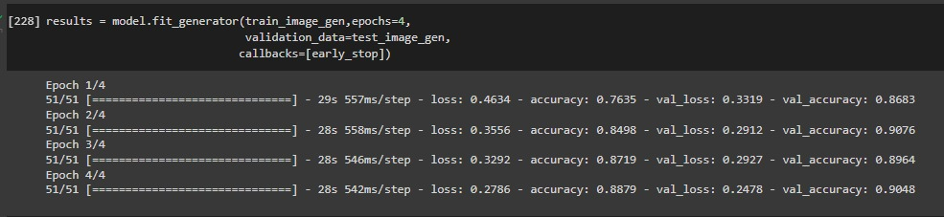
Accuracy
CNN Model

Slide 16
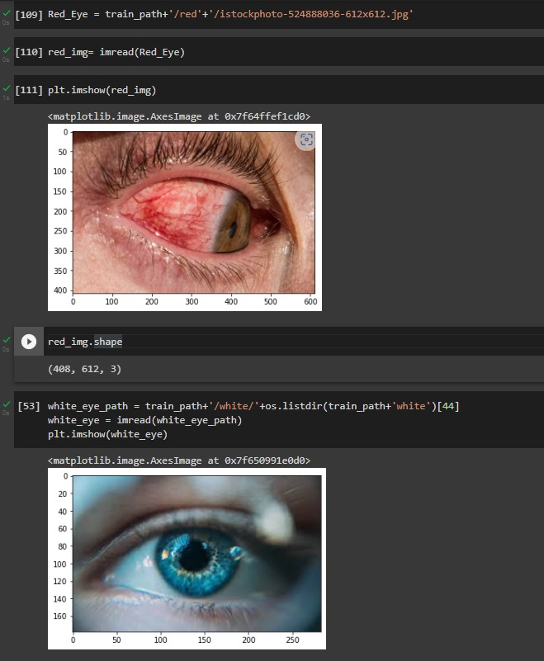
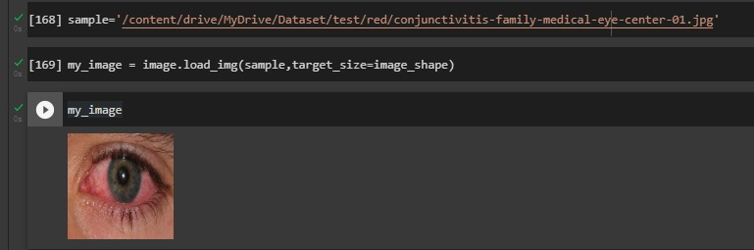
Testing
Training

Slide 17

Result

Slide 18
Conclusion
Detection of pink eye using Convoluted Neural Networks (CNN) is one of the hot research topics of today. In this study, we present our ﬁndings for automated diagnosing of pink eye (conjunctivitis) using only the eye images of the patients face. We have implemented this model using customised sequential model which consists of the following layers: Conv2D, Max pooling2D, Dense, Dropout, Activation, Flatten. This helped us achieve accuracy of 85%. This solid prediction performance can further be improved by using SVM algorithm.

Slide 19
References
[1] Melih Gunay; Evgin Goceri; Taner Danisman, “Automated Detection of Adenoviral Conjunctivitis Disease from Facial Images using Machine Learning”, Published in: 2015 IEEE 14th International Conference on Machine Learning and Applications (ICMLA)
[2] Hiroki Masumoto , Hitoshi Tabuchi, Tsuyoshi Yoneda, Shunsuke Nakakura, Hideharu Ohsugi,Tamaki Sumi, and Atsuki Fukushima, “Severity Classification of Conjunctival Hyperemia by Deep Neural Network Ensembles”, Published in: Journal of Ophthalmology ,2019
[3] Sherry Verma, Latika Singh, Monica Chaudhry, “Evaluation of Convolutional Neural Network Model for Classifying Red and Healthy Eye”, Published in: International Journal of Innovative Technology and Exploring Engineering (IJITEE), October, 2019

Slide 20
References
[4] Mrunalini Manchalwar , Krishna Warhade, “Detection of Cataract and Conjunctivitis Disease Using Histogram of Oriented Gradient” , Published in: International Journal of Engineering and Technology (IJET),Jun-Jul 2017
[5] Mingxin Yu,Xiaoying Tang,Yingzi Lin,David Schmidt, “An eye detection method based on convolutional neural networks and support vector machines”, Published in: Intelligent Data Analysis 22(2) ,March 2018

Slide 21
Future Enhancements
Improving the accuracy by training it with a more refined dataset.
Deploy it on Raspberry Pi
Adaptable model

Slide 22
Thank you!

